Slide 1
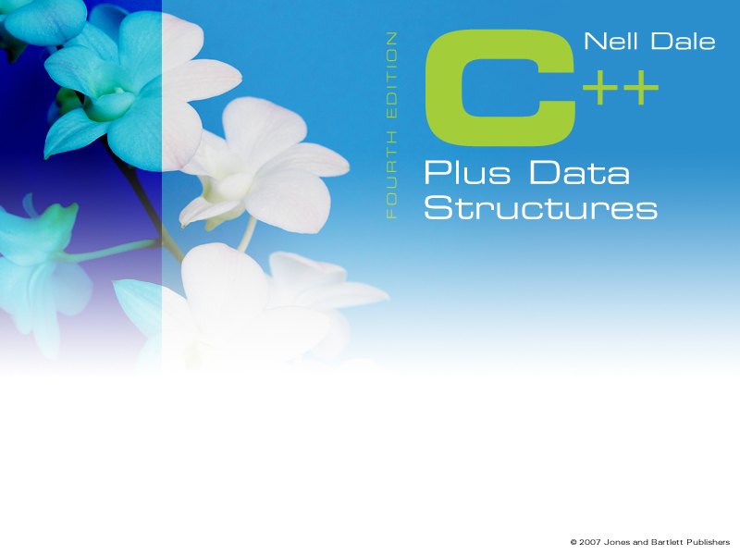
2
Data Design and Implementation
Chapter 2
Data Design and Implementation

Slide 2
Goals
Describe an ADT from three perspectives: logical level, application level, and implementation level
Explain how a specification can be used to record an abstract data type
Describe the component selector at the logical level and describe appropriate applications for the C++ built-in types: structs, classes, one-dimensional arrays, and two-dimensional arrays
Declare a class object
Implement the member functions of a class
Manipulate instances of a class (objects)

Slide 3
Goals
Define the three ingredients of an object-oriented programming language: encapsulation, inheritance, and polymorphism
Distinguish between containment and inheritance
Use inheritance to derive one class from another class
Use the C++ exception handling mechanism
Access identifiers within a namespace
Explain the use of Big-O notation to describe the amount of work done b an algorithm

Slide 4
Different Views of Data
Data
The representation of information in a manner suitable for communication or analysis by humans or machines
Data are the nouns of the programming world:
  The objects that are manipulated
  The information that is processed

Slide 5
Different Views of Data
Data Abstraction
Separation of a data type’s logical properties from its implementation
LOGICAL PROPERTIES IMPLEMENTATION
What are the possible values? How can this be done in C++?
What operations will be
needed? How can data types be used?

Slide 6
Different Views of Data
Data Encapsulation
The separation of the representation of data from the applications that use the data at a logical level; a programming language feature that enforces information hiding
APPLICATION
REPRESENTATION
0 0 0 0 0 0 0 0 0 0 0 1 1 0 0 1
int y;
y = 25;

Slide 7
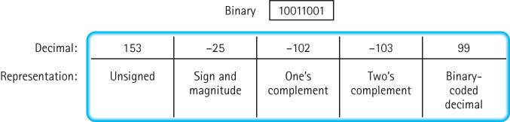
Different Views of Data
You don't need to know how a number is represented
in order to use in a program

Slide 8
Different Views of Data
TYPE
int
Value range:
INT_MIN . . INT_MAX
Operations:
+ prefix
- prefix
+ infix
- infix
* infix
/ infix
% infix
Relational Operators
infix
Representation of
int
as 16 bits two’s
complement
+
Implementation of
Operations
(inside)

Slide 9
Different Views of Data
Abstract Data Type
A data type whose properties (domain and operations) are specified independently of any particular implementation
Data Structure
A collection of data elements whose organization is characterized by accessing operations that are used to store and retrieve the individual elements; the implementation of the composite data members of an ADT

Slide 10
Different Views of Data
Application (or user) level modeling real-life data in a specific context
Logical (or ADT) level abstract view of the domain and operations
Implementation level specific representation of the structure to hold the data items, and the coding for operations

Slide 11
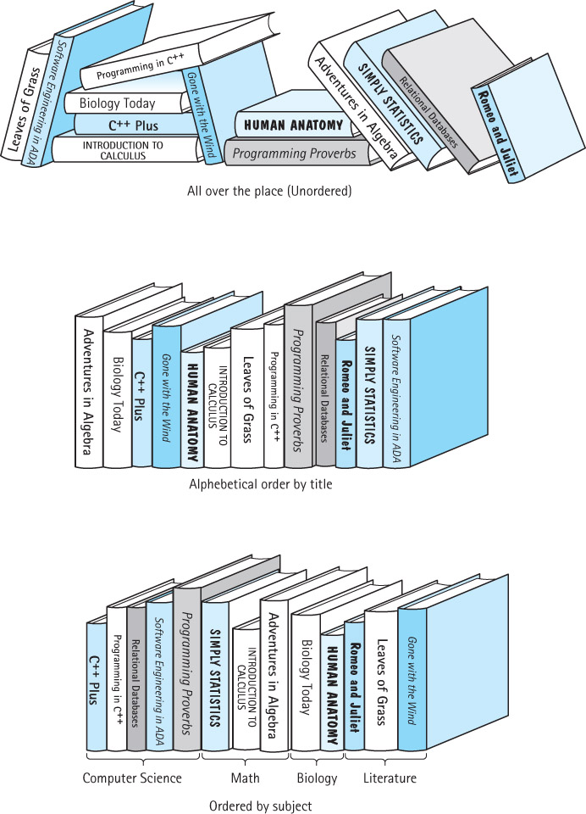
Different Views of Data
What is
the
application
view?
The
logical
view?
The
implementation
view?

Slide 12
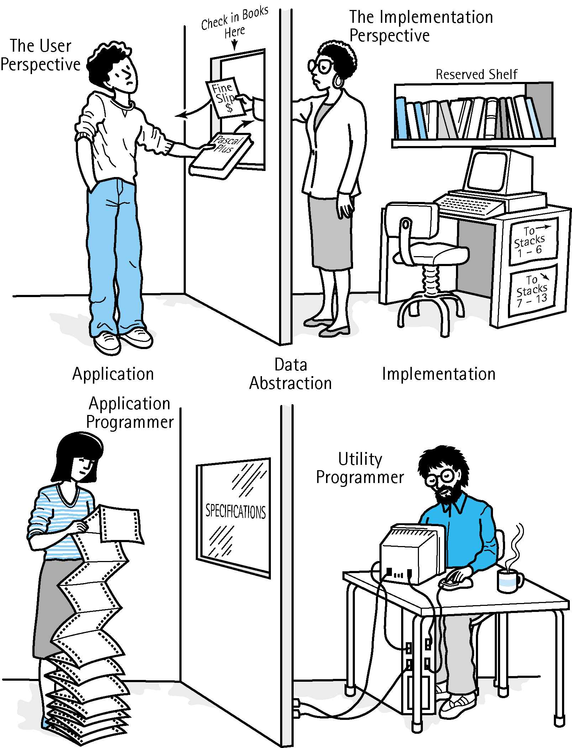
Different Views of Data
How do
the
application
and
implementation
view
communicate?

Slide 13
Different Views of Data
Application (or user) level Library of Congress, or Baltimore County Public Library
Logical (or ADT) level domain is a collection of books; operations include: check book out, check book in, pay fine, reserve a book
Implementation level representation of the structure to hold the “books” and the coding for operations

Slide 14
Different Views of Data
Which of these are “Gets”?
Which of these are “Sets”?
Classes of Operators
Constructors
Operation that creates new instances of an ADT; usually a language feature
Transformers (mutators)
Operations that change the state of one or more data values in an ADT
Observers
Operations that allow us to observe the state of the ADT
Iterators
Operations that allow us to access each member of a data structure in turn

Slide 15
Abstraction and Built-In Types
Composite data type
A data type that allows a collection of values to be associated with an object of that type
Unstructured data type
The components of the collection are not organized with respect to each other
Structured data type
The components of the collection are organized and the organization determines the accessing methods

Slide 16
Abstraction and Built-In Types
UNSTRUCTURED
STRUCTURED
Components are not
organized with respect to
one another
The organization
determines method used
to access individual
data components
EXAMPLES: EXAMPLES: arrays
classes and structs

Slide 17
C++ Built-In Data Types
Simple
Composite
Integral
Floating
array struct union class
char short int long enum
Address
float double long double
pointer reference

Slide 18
Abstraction and Built-In Types
Record (logical level)
A composite data type made up of a finite collection of not necessarily homogeneous elements called members or fields
struct CarType
{
int year;
char maker[10];
float price;
};
CarType myCar
myCar.price
dot
struct member
variable selector

Slide 19
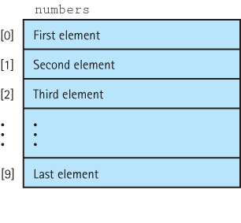
Abstraction and Built-In Types
One-dimensional array
A structured composite data type made up of a finite, fixed size collection of ordered homogeneous elements to which direct access is available
Logical level
int numbers[10]

Slide 20
Abstraction and Built-In Types
Implementation level
This ACCESSING FUNCTION gives position of values[Index]
Address(Index) = BaseAddress + Index * SizeOfElement
float values[5];//assume element size is 4 bytes
Base Address
7000 7004 7008 7012 7016
values[0] values[1] values[2] values[3] values[4]
Indexes

Slide 21
Abstraction and Built-In Types
This ACCESSING FUNCTION gives position of name[Index]
Address(Index) = BaseAddress + Index * SizeOfElement
char name[10]; // assume element size is 1 byte
Base Address
6000 6001 6002 6003 6004 6005 6006 6007 6008 6009
name[0] name[1] name[2] name[3] name[4] . . . . . name[9]

Slide 22
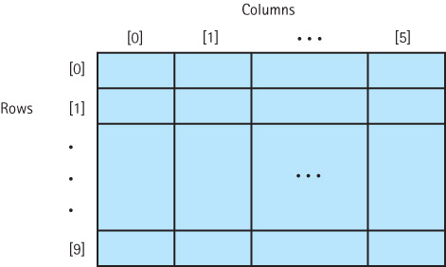
Abstraction and Built-In Types
A two-dimensional array
A structured composite data type made up of a finite, fixed size collection of homogeneous elements having relative positions and to which there is direct access
logical level
int data table[10][6];

Slide 23
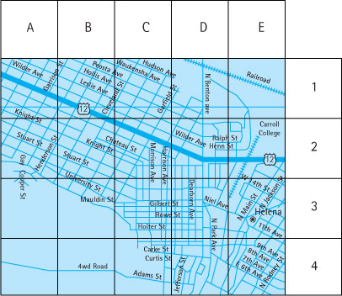
Abstraction and Built-In Types
Application Level
Can you think
of
other
applications
for
two-dimensional
arrays
?

Slide 24
const int NUM_STATES = 50 ; const int NUM_MONTHS = 12 ; int stateHighs [ NUM_STATES ] [ NUM_MONTHS ] ;
STORAGE
rows columns
C++ stores arrays in row order
Base Address
8000
8024
8048
. . .
12 highs for state 0 12 highs for state 1 etc.
Alabama Alaska
first row second row

Slide 25
Abstraction and Built-In Types
stateHighs[ 0 ] [ 0 ]
stateHighs[ 0 ] [ 1 ]
stateHighs[ 0 ] [ 2 ]
stateHighs[ 0 ] [ 3 ]
stateHighs[ 0 ] [ 4 ]
stateHighs[ 0 ] [ 5 ]
stateHighs[ 0 ] [ 6 ]
stateHighs[ 0 ] [ 7 ]
stateHighs[ 0 ] [ 8 ]
stateHighs[ 0 ] [ 9 ]
stateHighs[ 0 ] [10 ]
stateHighs[ 0 ] [11 ]
stateHighs[ 1 ] [ 0 ]
stateHighs[ 1 ] [ 1 ]
stateHighs[ 1 ] [ 2 ]
stateHighs[ 1 ] [ 3 ]
.
.
.
Base Address 8000
To locate an element such as
stateHighs [ 2 ] [ 7]
the compiler needs to know
that there are 12 columns
in this two-dimensional array
If int needs 2 bytes, at what
address will
stateHighs[2][7]
be found?

Slide 26
Higher-Level Abstraction
Class
An unstructured type that encapsulates a fixed number of data components (data members) with the functions (member functions) that manipulate them; its predefined operations on an instance of a class are whole assignment and component access
Client
Software that declares and manipulates objects (instances) of a particular class

Slide 27
Higher-Level Abstraction
Class specification
A specification of the class members (data and functions) with their types and/or parameters
Class implementation
The code that implements the class functions
Why would you want to
put them in separate
files?

Slide 28
Higher-Level Abstraction
If a class has a binary function where are the two parameters?
What do we mean by "self?"
What is the difference between a class and a struct?

Slide 29
Object-Oriented Programming
objects, sending a message, methods, instance variables….
Object
An instance of a class
Method
A public member function of a class
Instance variable
A private data member of a class

Slide 30

Object-Oriented Programming
Three ingredients in any object-oriented language
  encapsulation
  inheritance
  polymorphism
Just as a capsule protects
its contents, the
class construct protects
its data members, but
what are inheritance and
polymorphism
?

Slide 31
Object-Oriented Programming
Inheritance
A mechanism used with a hierarchy of classes in which each descendant class inherits the properties (data and operations) of its ancestor class
Base class
The class being inherited from
Derived class
the class that inherits

Slide 32
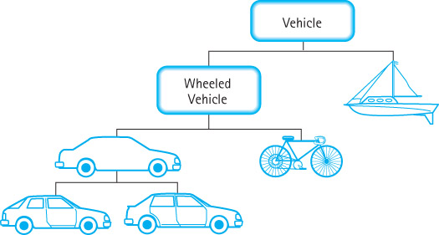
Object-Oriented Programming
Inheritance is
an "is-a"
relationship:
a
wheeled vehicle
is a vehicle;
a bicycle is a
wheeled vehicle
a four-door car
is a car…

Slide 33
Object-Oriented Programming
Binding time
The time at which a name or symbol is bound to the appropriate code
Static binding
The compile-time determination of which implementation of an operation is appropriate
Dynamic binding
The run-time determination of which implementation of an operation is appropriate

Slide 34
Object-Oriented Programming
Overloading
Giving the same name to more than one function or using the same operation symbol for more than one operation; usually associated with static binding
Polymorphism
The ability to determine which of several operations with the same name is appropriate; a combination of static and dynamic binding
What is the root of the
word polymorphism?

Slide 35
Object-Oriented Programming
Each class has a method Print
Person.Print just prints the name
Employee.Print prints the name and job title
Manager.Print prints name, job title, and department
Person
Employee
Manager
Print is overloaded
Static binding is when the compiler can tell which Print to use; dynamic binding is when the determination cannot be made until run time

Slide 36
Object-Oriented Programming
Inheritance and polymorphism work together
How?
They combine to allow the programmer to build useful hierarchies of classes that can be put into a library to be reused in different applications

Slide 37
Comparison of Algorithms
Some algorithms will perform faster than others.
It is important to be able to compare different algorithms so we can choose the best one for the problem at hand.
How can we compare algorithms???

Slide 38
Comparison of Algorithms
Can we use the actual time (say in milliseconds) it takes for a program to run to compare algorithms?

Slide 39
Comparison of Algorithms
Can we use the actual time (say in milliseconds) it takes for a program to run to compare algorithms?
NO. Not a good comparison
1. Computer speeds can vary.
2. If algorithms are run on the same computer the load that the OS is dealing with at any instant in time can vary.

Slide 40
Comparison of Algorithms
We need a higher level approach to compare algorithms.
Algorithm Comparison
  Isolate a particular operation that is fundamental to the algorithm.
  Then count the number of times that this operation is performed.
  This eliminates variables such as computer speeds and OS load.

Slide 41
Comparison of Algorithms
Pretend two people are preparing a normal dictionary book and each uses their own organization scheme to store the entries.
Person 1 – Puts the words in alphabetical order.
Person 2 – Puts the words in random order.
What metric should we use to compare the two algorithms?

Slide 42
Comparison of Algorithms
Algorithm Comparison
One operation we could count is the number of comparisons necessary to find an element.
How many entries would we have to “look at” in the dictionary before we found the one that we wanted?

Slide 43
Comparison of Algorithms
Pretend two people are writing a dictionary and each uses their own organization scheme to store the entries.
Person 1 – Puts the words in alphabetical order.
Person 2 – Puts the words in random order.
Under which person’s organization would it be faster to find a definition using comparison as the metric? Why?

Slide 44
Comparison of Algorithms
Person 1 – Puts the words in alphabetical order.
Person 2 – Puts the words in random order.
Person 1 is faster.
If there were 10 entries in the dictionary and the target entry is the last one then how many comparisons are needed?

Slide 45
Comparison of Algorithms
Person 1 – Puts the words in alphabetical order.
Person 2 – Puts the words in random order.
Person 1 is faster.
If there were 10 entries in the dictionary and the target entry is the last one then how many comparisons are needed?
ANSWER
10 Comparisons are needed

Slide 46
Comparison of Algorithms
Person 1 – Puts the words in alphabetical order.
Person 2 – Puts the words in random order.
We just compared the algorithms to see which one does a Find() faster.
What else could we compare?

Slide 47
Comparison of Algorithms
Person 1 – Puts the words in alphabetical order.
Person 2 – Puts the words in random order.
Now compare the speed it takes to add a new entry (Insert())?
Which algorithm is faster when putting new data in the dictionary (Insertion)?

Slide 48
Comparison of Algorithms
Person 1 – Puts the words in alphabetical order.
Person 2 – Puts the words in random order.
ANSWER:
Person 2 is faster in this case. All you have to do is put it at the end.
What do you have to do to put something in using the Person 1 algorithm?

Slide 49
Comparison of Algorithms
Person 1 – Puts the words in alphabetical order.
Person 2 – Puts the words in random order.
Person 1 requires that you first FIND the insertion place then you can insert it.

Slide 50
Comparison of Algorithms
Person 1 – Puts the words in alphabetical order.
Person 2 – Puts the words in random order.
If there were 10 entries how many comparisons would it take to find the correct insertion place using the Person 2 algorithm?

Slide 51
Comparison of Algorithms
Person 1 – Puts the words in alphabetical order.
Person 2 – Puts the words in random order.
If there were 10 entries how many comparisons would it take to find the correct insertion place using the Person 2 algorithm?
ANSWER
0 comparisons

Slide 52
Comparison of Algorithms
Person 2 – Puts the words in random order.
Assuming 10 entries and the target is at the end for a Find():
Algorithm | Runtime
Find() | 10 Comparisons
Insert() | 0 Comparisons

Slide 53
Comparison of Algorithms
Person 2 – Puts the words in random order.
Assuming 5000 entries and the target is at the end for a Find():
Algorithm | Runtime
Find() | 5000 Comparisons
Insert() | 0 Comparisons
Note
Insert() remains constant no matter how many entries there are in the dictionary using the random order organization scheme.

Slide 54
Comparison of Algorithms
Person 2 – Puts the words in random order.
Assuming 5000 entries and the target is at the middle point for a Find():
Algorithm | Runtime
Find() | ??? Comparisons
Insert() | ??? Comparisons

Slide 55
Comparison of Algorithms
Person 2 – Puts the words in random order.
Assuming 5000 entries and the target is at the middle point for a Find():
Algorithm | Runtime
Find() | 2500 Comparisons
Insert() | 0 Comparisons

Slide 56
Comparison of Algorithms
Person 2 – Puts the words in random order.
Assuming 5000 entries and the target is at the beginning of the dictionary while performing a Find():
Algorithm | Runtime
Find() | ??? Comparisons
Insert() | ??? Comparisons

Slide 57
Comparison of Algorithms
Person 2 – Puts the words in random order.
Assuming 5000 entries and the target is at the beginning of the dictionary while performing a Find():
Algorithm | Runtime
Find() | 1 Comparison
Insert() | 0 Comparisons

Slide 58
Comparison of Algorithms
Person 2 – Puts the words in random order.
Assume 5000 entries and you do not know where the target is. What is the average number of comparisons:
Algorithm | Runtime
Find() | ??? Comparison
Insert() | ??? Comparisons

Slide 59
Comparison of Algorithms
Person 2 – Puts the words in random order.
Assume 5000 entries and you do not know where the target is. What is the average number of comparisons:
Algorithm | Runtime
Find() | 2500 Comparison
Insert() | 0 Comparisons

Slide 60
Comparison of Algorithms
Person 2 – Puts the words in random order.
Assume you have n entries. Also, assume the target is at the end. Now how long?
Algorithm | Runtime
Find() | ??? Comparisons
Insert() | ??? Comparisons

Slide 61
Comparison of Algorithms
Person 2 – Puts the words in random order.
Assume you have n entries. Also, assume the target is at the end. Now how long?
Algorithm | Runtime
Find() | n Comparisons
Insert() | 0 Comparisons

Slide 62
Comparison of Algorithms
Person 2 – Puts the words in random order.
Assume you have n entries and you don’t know where the target is. What is the average runtime for each?
Algorithm | Runtime
Find() | ??? Comparisons
Insert() | ??? Comparisons

Slide 63
Comparison of Algorithms
Person 2 – Puts the words in random order.
Assume you have n entries and you don’t know where the target is. What is the average runtime for each?
Algorithm | Runtime
Find() | n/2 Comparisons
Insert() | 0 Comparisons
On average you will have to look through half the entries.

Slide 64
Comparison of Algorithms
Algorithm Comparison uses something called Big-O notation.
Assume you have n entries or data items.
A runtime of O(n) means you have to “look at” each item once. n comparisons are required.
So if there are 100 entries then n is 100. If there are 5000 entries then n is 5000.

Slide 65
Comparison of Algorithms
Assume you have n entries or data items.
O(1) means you have to “look” at one entry or time.
This is called “constant” time.
IMPORTANT
A O(1) running time will not change no matter what the value of n is.

Slide 66
Comparison of Algorithms
Big-O notation is used as an approximation or estimate of how long an algorithm will take.
It is not meant to be an exact number.

Slide 67
Comparison of Algorithms
What if we went to buy a car. While buying the car we also bought a bag of potato chips and a soda while we were waiting. Assume the following costs of the items that we just bought.
Approximately how much did we spend?
Item | Cost
Car | $25000
Potato Chips | $1
Soda | $2

Slide 68
Comparison of Algorithms
What if we went to buy a car. While buying the car we also bought a bag of potato chips and a soda while we were waiting. Assume the following costs of the items that we just bought.
Approximately how much did we spend?
Answer
Approximately $25000
Item | Cost
Car | $25000
Potato Chips | $1
Soda | $2

Slide 69
Comparison of Algorithms
When calculating Big-O runtimes you can “ignore” the small numbers.
You only need to look at the “big” numbers.
Look for the numbers that dominate the calculation.

Slide 70
Comparison of Algorithms
So what is the big-O answer for the following equation?
f(n) = O(n) + O(1) + O(1)

Slide 71
Comparison of Algorithms
So what is the big-O answer for the following equation?
f(n) = O(n) + O(1) + O(1)
Answer
f(n) = O(n)
Note
The O(n) piece dominates the rest of the equation so you can ignore the O(1) pieces

Slide 72
Comparison of Algorithms
So what is the big-O answer for the following equation?
f(n) = O(n/2) + O(1) + O(1)

Slide 73
Comparison of Algorithms
So what is the big-O answer for the following equation?
f(n) = O(n/2) + O(1) + O(1)
Answer
f(n) = O(n)
Note
You can ignore constants in equations. O(n/2) as O(n * ½). The ½ can be ignored.

Slide 74
Comparison of Algorithms
What are the run times for the operations of the MyArray class that you did for homework?

Slide 75
Comparison of Algorithms
There is a very important area of Computer Science called Analysis of Algorithms which deals with the comparison of algorithms.
Computer scientists can mathematically analyze algorithms and prove how long algorithms will take to run (approximately).
It is important to analyze algorithms or programs to find the best one when dealing with large amounts of data.

Slide 76
C++ Tips
Pass-by-value sends a copy of the contents of the actual parameter
CALLING
BLOCK
FUNCTION
CALLED
SO,
the actual parameter cannot be changed by the function

Slide 77
C++ Tips
Pass-by-reference sends the location
(memory address) of the actual parameter
CALLING
BLOCK
FUNCTION
CALLED
SO,
the actual parameter can be changed by the function

Slide 78
C++ Tips
Arrays as parameters
Because all arrays are passed by reference, the & does not have to appear on the parameter list
Whenever an array is passed as a parameter, its base address is sent to the called function
The size of all dimensions except the first must be included in the function heading and prototype.
The sizes of those dimensions for the formal parameter must be exactly the same as in the actual array
Why must they be the same?

Slide 79
C++ Tips
Go back and re-read the Scope Rules of C++

